Slide 1

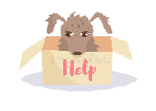
Raj Kumar Goel Institute Of Technology, Ghaziabad.
SHELTER
BY : ADITYA TYAGI (1900330100018)
: AKASH (1900330100019)
: EMAMUL HAQUE KHAN (1900330100089)
: KARTIK KAUSHIK (1900330100117)

Slide 2

3 W’s of SHELTER?
WHAT is Shelter?
WHY Shelter?
WHERE is Shelter Available?

Slide 3
What is Shelter?
Shelter is a pet adoption website which allow users to adopt pet across different areas in the country.
Pet adoption is the process of taking responsibility for a stray or of a previous owner has abandoned or released to a shelter or rescue organization. Common sources for adoptable pets are animal shelters and rescue groups. Some organizations give adopters ownership of the pet, while others use a guardianship model wherein the organization retains some control over the animal's future use or care.
Shelter has databases of pets being housed by thousands of animal shelters and rescue groups, and are searchable by the public.

Slide 4
Why Shelter?
Hundreds of pets are abandoned and rescued in India everyday. Although there are many wonderful souls across the nation who work extra hours and put in efforts beyond their capacity, there is always a shortage of funding and communication across the animal activist circuit. Keeping this issue in mind, we have launched Shelter. This online portal aims to establish a database of pet animals pets that are available in many cities and others across the country. We are here to not just display these pets but assist in the process by having a streamlined process in place which includes filling up of the adoption form as well as mediating between the two parties, namely the current foster/shelter of the pet and the potential adopting entity. Our ultimate goal is reduce pets over-population by providing loving homes for all the homeless pets , and at the same time helping every human share their lives with a furry companion that they so dearly want.

Slide 5
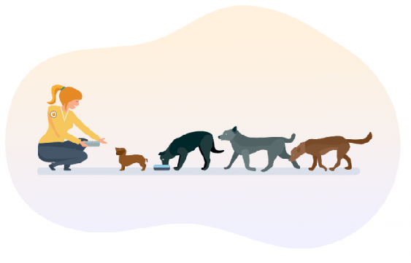
Where is Shelter Available?
Many adoption site and service are mainly active in big metro and smart cities. Shelter would be able to reach locally in nearby area.
Soon after more development our services would reach more and more distance....

Slide 6
Features:
List pet animals with their location.
Search and view the listed pets with breed.
Request to adopt the pets.
Favourite / Like the pets.

Slide 7
Reasons to Choose
The main reason to choose this project was that the idea was interesting and fun to work on.
Solve a realistic problem.
Lack of such platform in our country.
Features were practically attainable.

Slide 8
Technology Used:
Front-end
CSS & Bootstrap
Back-end
Java, SQL

Slide 9
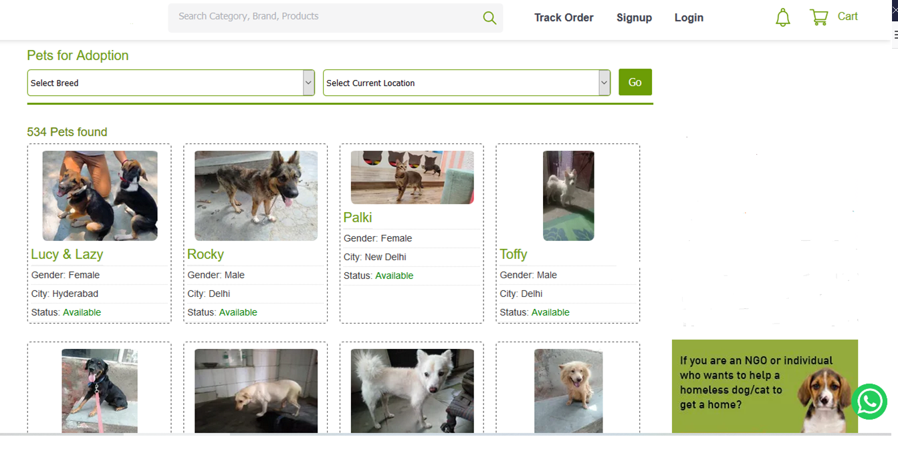
PREVIEW

